Slide 1
Guide Data Collection Tools

Slide 2
Programme Authorities
Smart Survey
Go to table of content

Slide 3
Content: the different parts of the questionnaire
Part A
Background
Respondents' information, organisations involved, programme budget & workload, …
Part B
Administrative Practices
Digitalisation + Use of Simplified Cost Options (SCOs)
Part C
Preparation
1.
Preparational tasks + Simplification measures related to those tasks.
General Management
General management tasks + Simplification measures related to those tasks.
2.
Financial Management
Financial management tasks + Simplification measures related to those tasks.
3.
Operations
Tasks related to Operations + Simplification measures related to those tasks.
4.
Reporting, monitoring and evaluation
Rep., mon. and eval. tasks + Simplification measures related to those tasks.
5.
Audit
Audit tasks + Simplification measures related to those tasks.
6.
Go to table of content

Slide 4
Respondents: which authority is likely to fill the different parts of the questionnaire?
Managing Authority
Intermediate Bodies
Audit Authority
Part A
Background
Audit Authority
Part B
Administrative Practices
Part C
Preparation
1.
General Management
2.
Financial Management
3.
Operations
4.
Reporting, monitoring and evaluation
5.
Audit
6.
This highly depends on the programme’s organisation and level of information centralisation: the MA will be able to indicate what bodies should participate on what parts depending on their own organisation!
Go to table of content

Slide 5
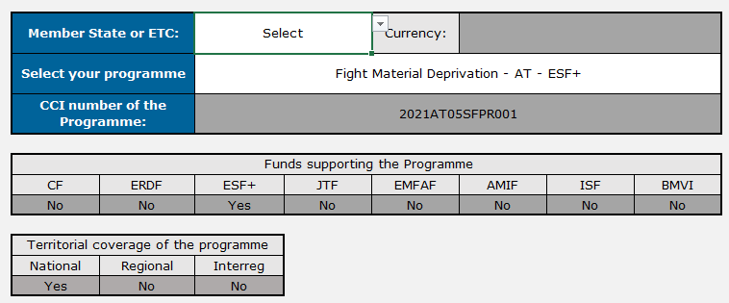
Background (excl. ETC-Interreg)
Select the MS
Filled automatically
Select the Programme
Filled automatically
Go to table of content

Slide 6
Background (ETC-Interreg)
Part 1 – Background – ETC (Interreg Programmes)
Select ETC
Select the currency
Select the Programme
Go to table of content

Slide 7
Respondents & Organisations
Only use the Latin alphabet.
Do not use abbreviations.
NOTE – For Interreg Programmes, ‘National Authorities’ and ‘Group of Auditors Representatives’ are considered Intermediate Bodies
Go to table of content

Slide 8
Yellow Cells
Throughout the survey, cells in yellow must be equal to 100% once the table is completed
Go to table of content

Slide 9
Administrative Practices Sheet – Digital Tools
Part 2 – Administrative Practices
(1) Select ‘Yes’ for all the levels for which there exist a digital tool related
to the management of the 2121-2027 CPR funds
(1) Provide the estimated reduction in FTEs allowed by
the use of the corresponding tool
Go to table of content

Slide 10
Administrative Practices Sheet – SCOs
Select the answer (to a small extent, to a great extent, etc…)
Go to table of content

Slide 11
Full-Time Equivalents (FTEs)
Full-time equivalents (FTE, per year) refers to the total number of hours worked by all employees in a given year when considering part-time employees in terms of the equivalent full-time work they represent. This metric is commonly used to standardise and compare workloads across employees with different working hours. For example, if an organisation has two part-time employees working 20 hours a week each, they collectively represent one full-time equivalent (FTE) per year, as their combined hours (40 hours per week) equate to a full-time employee's workload for a year.
$$FTE (per year)=\frac{Total hours worked during a year}{Total working hours per year}$$
Please note that, when we are asking for an estimation of the FTEs for a certain task:
FTEs are indicated on a yearly average basis over the whole period (including programme preparation and closure)
Only consider FTEs relevant to the management of the 2021-2027 CPR Funds.
Go to table of content

Slide 12
Overhead Costs
Part 2 – Administrative Practices
See slide above on FTEs
Overhead costs include:
- Common services (reception, registry, etc.)
- Telephone, Fax, Internet
- Office rent
- Stationary
- Etc.
+ EXTERNAL COSTS (E.g., amount paid to consultants!)
If necessary, estimate the proportion of those taken up by the management of the 2021-2027 CPR Funds within the organisation/ministry/…
Go to table of content

Slide 13
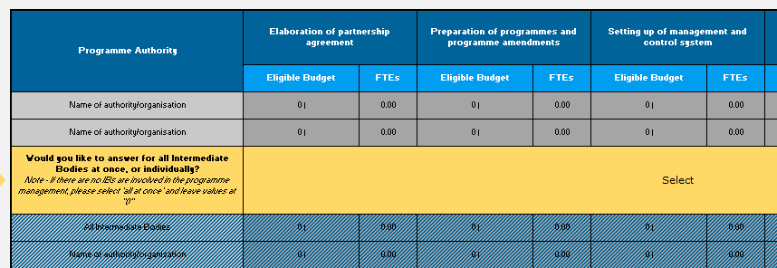
Reporting Eligible Budgets and FTEs per Task Area
Automatically filled
Drop-down list: please select if information about Intermediate Bodies is entered for all IBs at once, or individually. The right lines to be filled will appear accordingly
.
Managing and Audit Authorities. The lines appear when they fill the names in the background section
Intermediate Bodies. The lines appear when they fill the names in the background section
Go to table of content

Slide 14
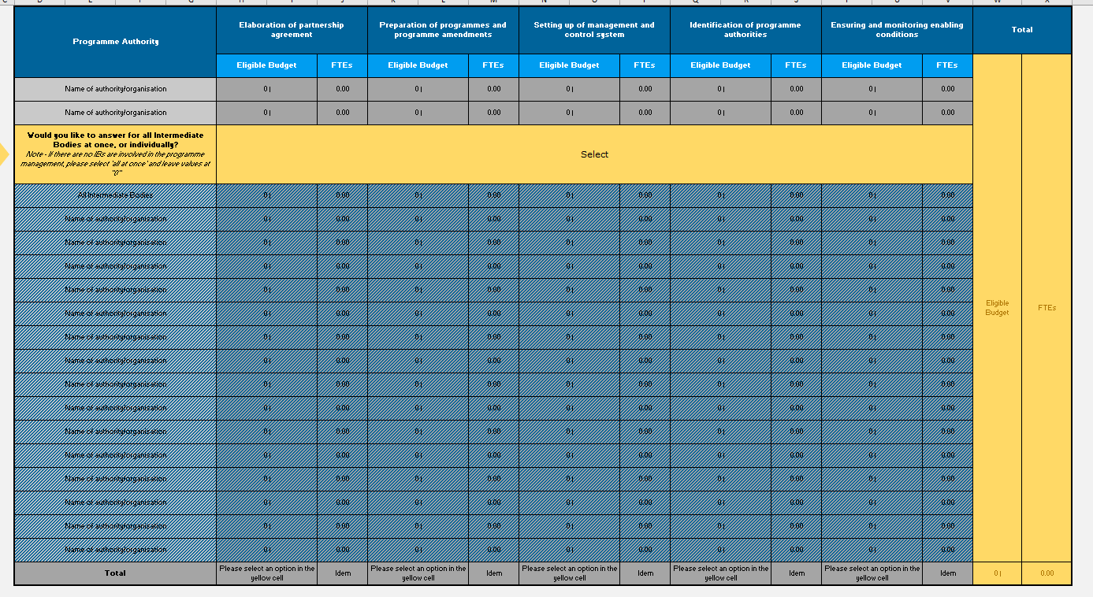
Reporting Eligible Budgets and FTEs per Task Area
REMINDER: these are the numbers to be reached
Once all relevant bodies/organisations fill-in the table and indicate the eligible budget and FTEs used for each subtask, their total should be equal to the eligible budget and FTEs indicated in the background sheet for this task area. The cells will appear red if this is not the case, and green when it matches. The table at the top of the sheet is a reminder of the numbers to be reached, i.e. the eligible budget and FTEs to ‘allocate’ among the different subtasks
Should be equal!
TOTAL:
Go to table of content
Eligible Budget and
FTEs for this task area

